Slide 1
Lecture 16
Prototyping
CS 4310: Software Engineering

Slide 2
Outline
Definitions
Uses of prototyping in the design process
Prototyping approaches
Prototyping “technologies”
Examples of prototyping
Discussion of your prototyping needs and approaches

Slide 3
Definitions
Prototypes should exhibit and make vivid and comprehensible the essential features of the system that is being designed, and of its style of user interface, i.e., its look and feel.
Prototypes should suggest what the application will do, what its essential characteristics are, what it will look like, and how it is to be used.

Slide 4
Prototypes are Used for Envisions
Prototypes are used to help one visualize things that do not yet exist
Prototypes are used for
  Designing media, systems, and interfaces
  Pre-testing media, systems, and interfaces
  Presenting interface ideas

Slide 5
Envision in Design
Visualizing concepts
Exploring alternatives
Resolving feature details
Developing interaction scenarios
  Visually showing your USE CASE scenarios

Slide 6
Envision in Pre-testing
Can you read or interpret this?
Can you follow this?
Can you make this work?
Do you understand what is going on?
Is this the way you would do this?
Does this suggest alternate approaches to you?

Slide 7
Envision for Presentation and Discussion
To interface designers, for discussion
To programmers, to guide implementation
To marketing and management, to guide product design and marketing decisions
To users, to get early feedback

Slide 8
Fidelity of Prototypes
“High fidelity” versus “low fidelity” prototypes
Degree of fidelity
  Increasing functionality
  Greater set of allowable inputs
  More realism in interaction style
  Greater detail in visual appearance

Slide 9
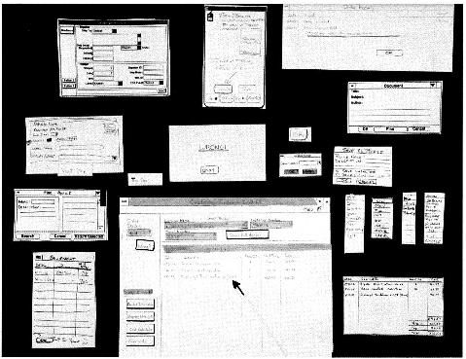
Low Fidelity Prototyping Example
Example made with heavy paper, cards, post-it notes, correction tape, photocopies, scissors…

Slide 10
Low Fidelity Prototypes
Use of standard office supplies
No computers involved
Modularity required, all interface elements on separate physical surfaces
Interactivity involved, with human playing computer, substituting physical elements as needed for interaction
Testing best done as a team

Slide 11
1D Media and Tools
Scripts, scenarios... e.g., USE CASE scenarios
Role-playing exercises
  Human plays computer
  Can simulate complex functionality with human “behind the curtain”

Slide 12
2D Media and Tools
Drawings, sketches
Screen shots
Storyboards
Flipbooks
Collections of post-its and cut-outs
Paper or cardboard mockups

Slide 13
3D Media and Tools
Puppets
Physical models
Computer animation
Videos
Interactive software “rapid prototypes”

Slide 14
Interactive Software Prototyping Tools
HyperCard (Apple's development tool)
Director and Flash
Visual Basic
Web-based prototyping
Dreamweaver
Java Applets

Slide 15
Hypercard
A prototyping system
  Accessible to non-programmers
  Interface builder
  Direct manipulation system
  Object-oriented system
Prototype construction in HyperCard
  Design the screens, which tend to look like cards, interactively
  Design the interaction, which is activated when people point at certain objects such as menus, press or release mouse button, or move cursor into certain regions, by writing scripts in an English-like programming language called HyperTalk

Slide 16
Hypercard
Some interface limitations to HyperCard
  Best for card-based interfaces
  Not good for interactive text manipulation
  Not good for sketching, gesture-based interfaces
Some HyperTalk language limitations
  No arrays
  Little (weird) program structure
  Few debugging tools

Slide 17
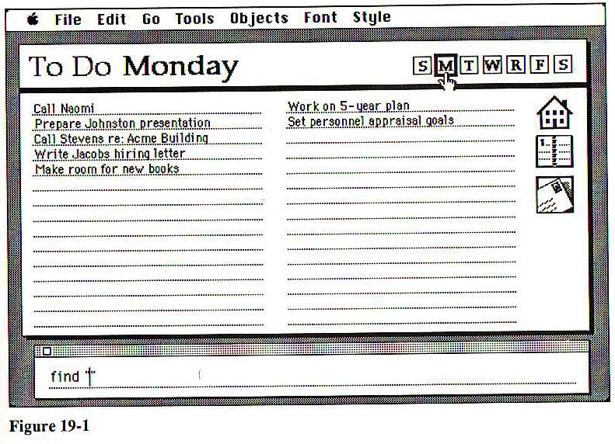
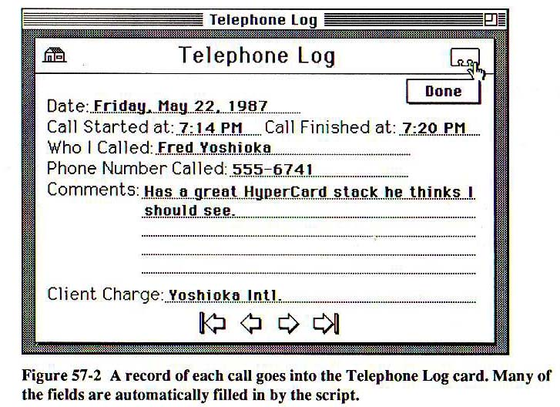
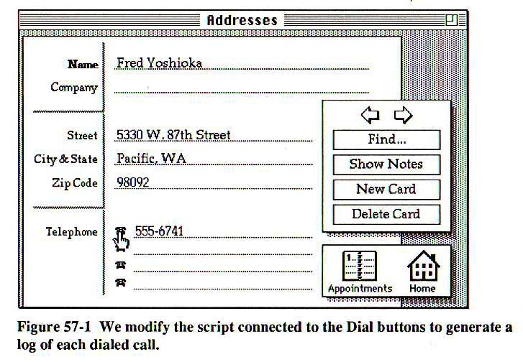
HyperCard Examples

Slide 18
Director
Features of Director
  System for computer animation, structuring images and their changes over time
  One central timeline
  Theatre as the unifying metaphor — actors, stage, etc.
  Easily accessible to non-programmers
  Scripting language — Lingo
  An extensible, object-oriented system
Limitations to Director
  Lingo language not easily accessible to non-programmers
  Need two versions for cross-platform work on PC and Mac

Slide 19
Difference between Director and Flash
Flash is better suited for site interface design
Flash tends to bog down when a lot of elements are on the screen.
Director is better for game development and complicated interface programming
Director has a much stronger timer than Flash
Flash sacrifices some of the UI control for ease of use
Flash is a lot easier to use than Director but not as feature rich.

Slide 20
Flash compared to Director
Flash is significantly cheaper than Director
Less powerful than Director
  No 3D modeling and animation
  Less access to hardware resources
  No XML
Multiple timelines, for individual scenes
Scripting language — Actionscript
Actionscript easily accessible to non-programmers

Slide 21
Visual Basic
Features of Visual Basic
  Interactive definition of screens and how they relate through interaction
  Definition of functionality and logic of interaction in the Basic programming language
  More expressive & powerful language than HyperTalk, Lingo, or Actionscript
Limitations to Visual Basic
  Not as accessible to non-programmers
  Language gets very hairy very quickly

Slide 22
Web-based Prototyping
Ensembles of tools
  HTML for defining Web pages (static and interactive)
  Image maps for representing graphics (that are interactive)
  JavaScript for defining logic of interaction
  Java applets for defining functionality
Dreamweaver
  Direct manipulation system that insulates interface designer from much of this detail

Slide 23
Prototype Goals
Show the scenarios
  You need to capture the CHARACTERISTICS of your system or device.
  Strike a balance. Choose the appropriate level of detail to illustrate your IDEA to the user.
  Pick out only the important details and concentrate on executing those well. The level of detail determines the amount of information required, so do not do more than needed.

Slide 24
Practical prototyping…
Remain flexible
  Remember that your first prototype will not be your last. If your design is to progress, you must be willing to iterate the idea over and over again.
Materials/Implementation
  Choose materials that are easy to manipulate, ones you feel comfortable using.
  Make something that is pleasant to look at.
  Allow for strength, create prototypes that can handle a lot of use. Reject ideas that are too fragile and complicated, whenever possible simplify.

Slide 25
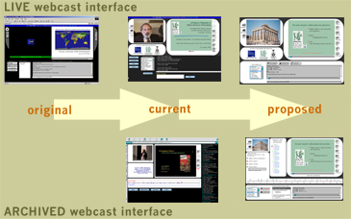
Interface prototype example
  Implemented with HTML
  Multiple user interface iteration cycle, based on extensive user feedback and detailed design review

Slide 26
Discussion of Prototyping for Projects
What type of prototype will you need?
  Software prototypes
What type of materials will you need?
  Some type of software tool
What should be implemented in the prototype?
  The user-interface look and feel
  The features to show overall functionality

Slide 27
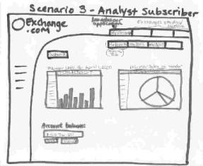
Prototype the design
Prototypes let you simulate a lot of detail of an interface.
They allow presentations to the user
The “Wizard of Oz” method
has the designer simulate the
behavior as well as the
appearance of the system

Slide 28
Use Prototyping to Animate Benefits
Easy to discover problems for end-user
  Suggest how the requirements may be improved
May be used to develop system tests
  Used later in the system validation process
  Executable prototypes may be used for back-to-back testing with the final system
May serve as a stop-gap system
  When delaying in implementing final system
Reveals requirements inconsistencies and incompleteness

Slide 29
Test the prototype
Scenarios and role-playing are no substitute for user testing.
Test with users with similar backgrounds to your target users.
Doing the design will give you a large set of expectations about what users will do with the design.
Testing will reinforce or contradict your expectations. You learn from that process.

Slide 30

Benefits of Testing
Testing will expose problems
You can then attack those problems in order of severity - and work on features in order of value
Beware of interactions between design elements - fixing one may break another
Design
Prototype
Evaluate

Slide 31
Project Work
Continue to work on your Design Specification Documents
Continue to work on your prototype

